Slide 1
Big Data
Mapreduce Basics
LEVEL – PRACTITIONER

Slide 2
Sudarshan Shetty
Manager-Big Data / 10 Years
1.0

Slide 3









Icons Used
Hands on Exercise
Questions
Tools
Coding Standards
Test Your Understanding
Case Study
Best Practices & Industry Standards
Demonstration
Workshop

Slide 4
Overview
This chapter will introduce you to the concepts of parallel processing using Mapreduce paradigm.

Slide 5
Objectives
After completing this chapter you will be able to :
Describe a Mapreduce job and its components
Advantages of a Mapreduce job
Explain Job submission and execution
Explain Task execution
Explain Failure of Task and Job
Describe various input formats
Describe various output formats
Describe Input Splits
Write a Mapreduce program

Slide 6
What is Mapreduce
MapReduce is a programming model designed for processing large volumes of data in parallel by dividing the work into a set of independent tasks.

Slide 7
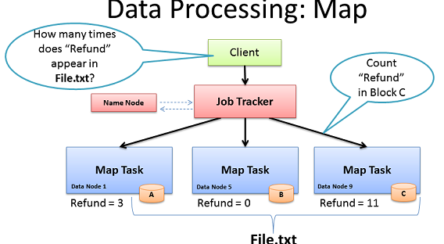
Map Phase
The first phase of a MapReduce program is called mapping. A list of data elements are provided, one at a time, to a function called the Mapper, which transforms each element individually to an output data element.

Slide 8
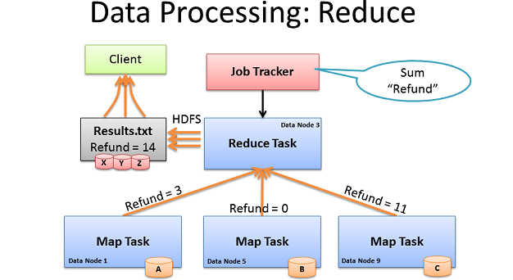
Reduce Phase
Reducing lets you aggregate values together. A reducer function receives an iterator of input values from an input list. It then combines these values together, returning a single output value.

Slide 9
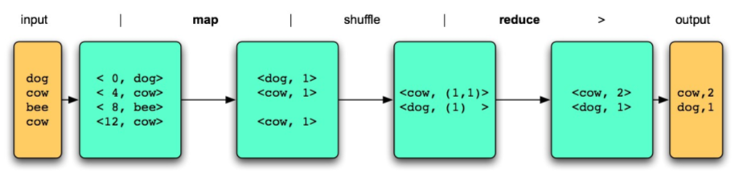
MapReduce Programming Model
User define two functions
map (K1, V1) → list(K2, V2)
takes an input pair and produces a set of intermediate key/value
reduce (K2, list(V2)) → list(K3, V3)
accepts an intermediate key I and a set of values for that key. It merges together these values to form a possibly smaller set of values
shuffle / sorting

Slide 10
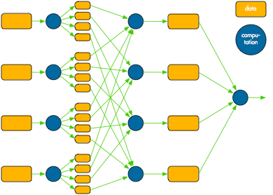
Mapreduce Architecture

Slide 11
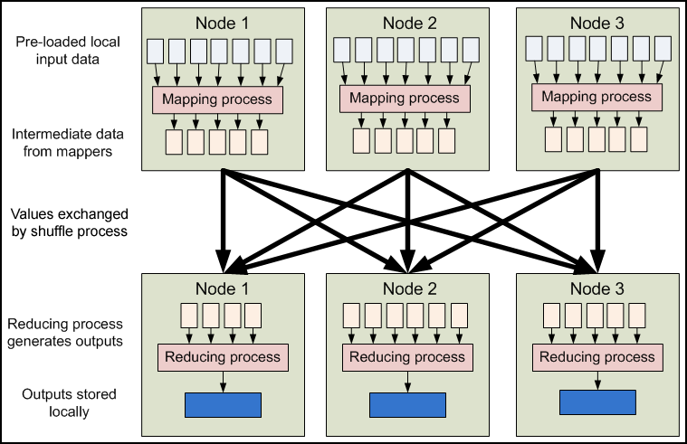
MapReduce Execution Flow

Slide 12
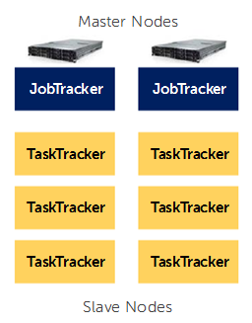
MapReduce Components
At the highest level, there are four independent entities:
The client, which submits the MapReduce job.
The jobtracker, which coordinates the job run. The jobtracker is a Java application whose main class is JobTracker.
The tasktrackers, which run the tasks that the job has been split into. Tasktrackers are Java applications whose main class is TaskTracker.
The distributed filesystem (normally HDFS), which is used for sharing job files between the other entities.

Slide 13
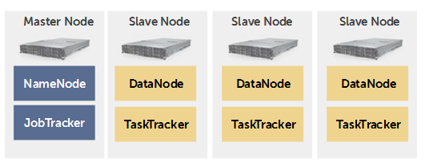
HDFS and Mapreduce Infrastructure
NameNode and JobTracker on the same server
DataNode and TaskTracker on the same server

Slide 14
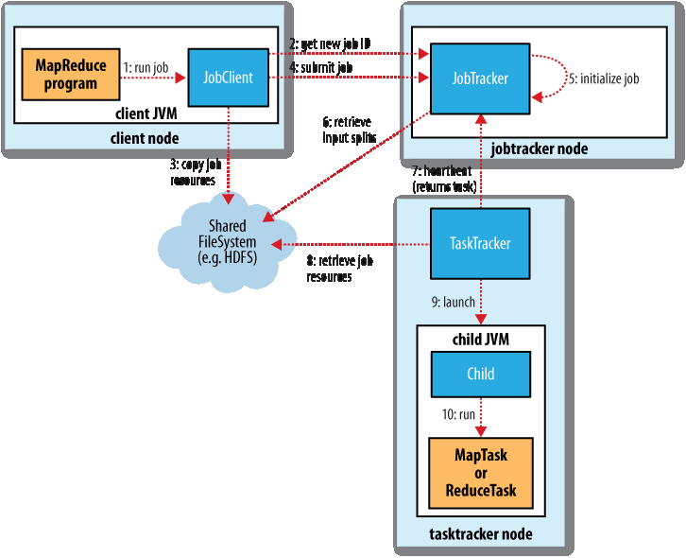
MapReduce Anatomy

Slide 15
Job submission process
JobClient’s submitJob() asks the jobtracker for a new job ID (by calling getNewJobId() on JobTracker)
Checks the output specification of the job. For example, if the output directory has not been specified or it already exists, the job is not submitted and an error is thrown to the MapReduce program.
Computes the input splits for the job. If the splits cannot be computed, because the input paths don’t exist, for example, then the job is not submitted and an error is thrown to the MapReduce program.
Copies the resources needed to run the job, including the job JAR file, the configuration file and the computed input splits, to the jobtracker’s filesystem in a directory named after the job ID. The job JAR is copied with a high replication factor (controlled by the mapred.submit.replication property, which defaults to 10) so that there are lots of copies across the cluster for the tasktrackers to access when they run tasks for the job.

Slide 16
Job Initialization
When the JobTracker receives a call to its submitJob() method, it puts it into an internal queue from where the job scheduler will pick it up and initialize it.
Initialization involves creating an object to represent the job being run.
To create the list of tasks to run, the job scheduler first retrieves the input splits computed by the JobClient from the shared filesystem . It then creates one map task for each split.

Slide 17
Task Assignment
Tasktrackers run a simple loop that periodically sends heartbeat method calls to the jobtracker. Heartbeats tell the jobtracker that a tasktracker is alive.
As a part of the heartbeat, a tasktracker will indicate whether it is ready to run a new task, and if it is, the jobtracker will allocate it a task, which it communicates to the tasktracker using the heartbeat return value.
Tasktrackers have a fixed number of slots for map tasks and for reduce tasks.

Slide 18
Task Execution
The job JAR is copied from the shared filesystem to the tasktracker’s filesystem creates a local working directory for the task, and un-jars the contents of the JAR into this directory.
Creates an instance of TaskRunner to run the task.
TaskRunner launches a new Java Virtual Machine to run each task in, so that any bugs in the user-defined map and reduce functions don’t affect the tasktracker.
The child process communicates with its parent through the umbilical interface

Slide 19
Progress and Status Updates
If a task reports progress, it sets a flag to indicate that the status change should be sent to the tasktracker.
The flag is checked in a separate thread every three seconds, and if set it notifies the tasktracker.
The tasktracker is sending heartbeats to the jobtracker every five seconds for the current task status.
The jobtracker combines these updates to produce a global view of the status of all the jobs being run and their constituent tasks.
JobClient receives the latest status by polling the jobtracker every second.

Slide 20
Job Completion
When the jobtracker receives a notification that the last task for a job is complete, it changes the status for the job to “successful.”
Then, when the JobClient polls for status,it learns that the job has completed successfully, so it prints a message to tell the user, and then returns from the runJob() method

Slide 21
Job Scheduling
Early versions of Hadoop had a very simple approach to scheduling users’ jobs: they ran in order of submission, using a FIFO scheduler.
Later on, the ability to set a job’s priority was added, via the mapred.job.priority property or the setJobPriority() method on JobClient (both of which take one of the values VERY_HIGH, HIGH, NORMAL, LOW, VERY_LOW).
Default - FIFO Scheduler

Slide 22
The Fair Scheduler
The Fair Scheduler aims to give every user a fair share of the cluster capacity over time. If a single job is running, it gets all of the cluster. As more jobs are submitted, free task slots are given to the jobs in such a way as to give each user a fair share of the cluster.
Jobs are placed in pools, and by default, each user gets their own pool. A user who submits more jobs than a second user will not get any more cluster resources than the second, on average.

Slide 23
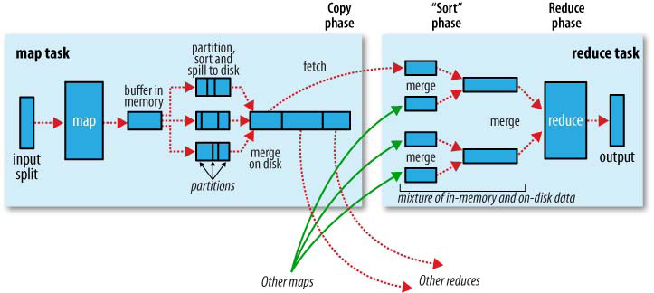
Mapreduce Internals

Slide 24
The Map Side
When the map function starts producing output, it is not simply written to disk.
Each map task has a circular memory buffer that it writes the output to. The buffer is 100 MB by default, a size which can be tuned by changing the io.sort.mb property
When the contents of the buffer reaches a certain threshold size (io.sort.spill.per cent, default 0.80, or 80%) a background thread will start to spill the contents to disk.
Map outputs will continue to be written to the buffer while the spill takes place, but if the buffer fills up during this time, the map will block until the spill is complete.
Before it writes to disk, the thread first divides the data into partitions corresponding to the reducers that they will ultimately be sent to. Within each partition, the background thread performs an in-memory sort by key, and if there is a combiner function, it is run on the output of the sort.

Slide 25
Shuffle and Sort
MapReduce makes the guarantee that the input to every reducer is sorted by key.
The process by which the system performs the sort—and transfers the map outputs to the reducers as inputs—is known as the Shuffle.

Slide 26
How do reducers know which tasktrackers to fetch map output from?
As map tasks complete successfully, they notify their parent tasktracker of the status update, which in turn notifies the jobtracker. These notifications are transmitted over the heartbeat communication mechanism. Therefore, for a given job, the jobtracker knows the mapping between map outputs and tasktrackers.
A thread in the reducer periodically asks the jobtracker for map output locations until it has retrieved them all.
Tasktrackers do not delete map outputs from disk as soon as the first reducer has retrieved them, as the reducer may fail. Instead, they wait until they are told to delete them by the jobtracker, which is after the job has completed.

Slide 27
Task JVM Reuse
Hadoop runs tasks in their own Java Virtual Machine to isolate them from other running tasks.
Jobs that have a large number of very short-lived tasks (these are usually map tasks) or that have lengthy initialization, can see performance gains when the JVM is reused for subsequent tasks.
With task JVM reuse enabled, tasks do not run concurrently in a single JVM. The JVM runs tasks sequentially.
Tasktrackers can however run more than one task at a time, but this is always done in separate JVMs.

Slide 28
Skipping Bad Records
The best way to handle corrupt records is in your mapper or reducer code. You can detect the bad record and ignore it, or you can abort the job.
In rare cases, though, you can’t handle the problem because there is a bug in a thirdparty library that you can’t work around in your mapper or reducer. In these cases, you can use Hadoop’s optional skipping mode for automatically skipping bad records
When skipping mode is enabled, tasks report the records being processed back to the tasktracker. When the task fails, the tasktracker retries the task, skipping the records that caused the failure. by throwing an exception

Slide 29
Steps to skip bad records
The best way to handle corrupt records is in your mapper or reducer code. You can detect the bad record and ignore it, or you can abort the job.
In rare cases, though, you can’t handle the problem because there is a bug in a thirdparty library that you can’t work around in your mapper or reducer. In these cases, you can use Hadoop’s optional skipping mode for automatically skipping bad records
When skipping mode is enabled, tasks report the records being processed back to the tasktracker. When the task fails, the tasktracker retries the task, skipping the records that caused the failure. by throwing an exception

Slide 30
Task Failure
User code in the map or reduce task throws a runtime exception.
Child JVM reports the error back to its parent tasktracker, before it exits.
The error ultimately makes it into the user logs.
The tasktracker marks the task attempt as failed, freeing up a slot to run another task.
Hanging tasks
The tasktracker notices that it hasn’t received a progress update for a while, and proceeds to mark the task as failed.
The child JVM process will be automatically killed after this period
The timeout period after which tasks are considered failed is normally 10 minutes

Slide 31
Rescheduling task
When the jobtracker is notified of a task attempt that has failed (by the tasktracker’s heartbeat call) it will reschedule execution of the task.
The jobtracker will try to avoid rescheduling the task on a tasktracker where it has previously failed
If a task fails more than four times, it will not be retried further.
The maximum number of attempts to run a task is controlled by the mapred.map.max.attempts property for map tasks, and mapred.reduce.max.attempts for reduce tasks.

Slide 32
Tasktracker Failure
If a tasktracker fails by crashing, or running very slowly, it will stop sending heartbeats to the jobtracker.
The jobtracker will notice a tasktracker that has stopped sending heartbeats and remove it from its pool of tasktrackers to schedule tasks on.
The jobtracker arranges for map tasks that were run and completed successfully on that tasktracker to be rerun if they belong to incomplete jobs, since their intermediate output residing on the failed tasktracker’s local filesystem may not be accessible to the reduce task.
A tasktracker can also be blacklisted by the jobtracker, even if the tasktracker has not failed. A tasktracker is blacklisted if the number of tasks that have failed on it is significantly higher than the average task failure rate on the cluster.
Blacklisted tasktrackers can be restarted to remove them from the jobtracker’s blacklist.

Slide 33
Jobtracker Failure
Failure of the jobtracker is the most serious failure mode.
Currently, Hadoop has no mechanism for dealing with failure of the jobtracker—it is a single point of failure—so in this case the job fails.

Slide 34
Workshop
Instruction:
Walkthrough of Mapreduce scripts and processes
Installing a Cloudera VM
Running a Mapreduce program
Going through Cloudera Tools

Slide 35
Test Your Understanding
Describe a Mapreduce job and its components ?
What are the Advantages of a Mapreduce job ?
Describe Task failure and recovery ?
How can bad records be skipped ?
How do reducers know which tasktrackers to fetch map output from?

Slide 36
Summary
The first phase of a MapReduce program is called mapping. A list of data elements are provided, one at a time, to a function called the Mapper, which transforms each element individually to an output data element.
Reducing lets you aggregate values together. A reducer function receives an iterator of input values from an input list. It then combines these values together, returning a single output value.
At the highest level, there are four independent entities:
Client, Mapper, Reducer and HDFS.
When skipping mode is enabled, tasks report the records being processed back to the tasktracker. When the task fails, the tasktracker retries the task, skipping the records that caused the failure. by throwing an exception

Slide 37
Input Splits and Records
Input splits are represented by the Java interface, InputSplit.
An InputSplit has a length in bytes, and a set of storage locations
split doesn’t contain the input data; it is just a reference to the data.
We don’t need to deal with InputSplits directly, as they are created by an InputFormat.

Slide 38
Input Format
An InputFormat is responsible for creating the input splits, and dividing them into records
FileInputFormat is the base class for all implementations of InputFormat that use files as their data source

Slide 39
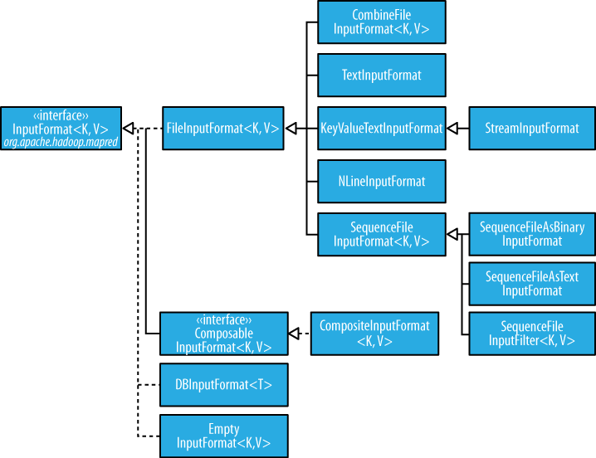
Input format Hierarchy

Slide 40
Small files and CombineFileInputFormat
Hadoop works better with a small number of large files than a large number of small files.
One reason for this is that FileInputFormat generates splits in such a way that each split is all or part of a single file. If the file is very small (“small” means significantly smaller than an HDFS block) and there are a lot of them, then each map task will process very little input, and there will be a lot of them (one per file), each of which imposes extra bookkeeping overhead.
The situation is alleviated somewhat by CombineFileInputFormat, which was designed to work well with small files. Where FileInputFormat creates a split per file, CombineFileInputFormat packs many files into each split so that each mapper has more to process.

Slide 41
TextInputFormat
TextInputFormat is the default InputFormat. Each record is a line of input.
The key, a LongWritable, is the byte offset within the file of the beginning of the line.
The value is the contents of the line, excluding any line terminators.
On the top of the Crumpetty Tree
The Quangle Wangle sat,
But his face you could not see,
On account of his Beaver Hat.
Its divided into one split of four records. The records are interpreted as the following
key-value pairs:
(0, On the top of the Crumpetty Tree)
(33, The Quangle Wangle sat,)
(57, But his face you could not see,)
(89, On account of his Beaver Hat.)

Slide 42
KeyValueTextInputFormat
TextInputFormat’s keys, being simply the offset within the file, are not normally very useful. It is common for each line in a file to be a key-value pair, separated by a delimiter such as a tab character. For example, this is the output produced by TextOutputFormat, Hadoop’s default OutputFormat. To interpret such files correctly, KeyValueTextInputFormat is appropriate.
specify the separator via the key.value.separator.in.input.line property
line1→On the top of the Crumpetty Tree
line2→The Quangle Wangle sat,
line3→But his face you could not see,
line4→On account of his Beaver Hat.
keys are the Text sequences before the tab in each line:
(line1, On the top of the Crumpetty Tree)
(line2, The Quangle Wangle sat,)
(line3, But his face you could not see,)
(line4, On account of his Beaver Hat.)

Slide 43
NLineInputFormat
If you want your mappers to receive a fixed number of lines of input, then NLineInputFormat is the InputFormat to use.
Like TextInputFormat, the keys are the byte offsets within the file and the values are the lines themselves.
On the top of the Crumpetty Tree
The Quangle Wangle sat,
But his face you could not see,
On account of his Beaver Hat.
If, for example, N is two, then each split contains two lines. One mapper will receive the first two key-value pairs:
(0, On the top of the Crumpetty Tree)
(33, The Quangle Wangle sat,)
And another mapper will receive the second two key-value pairs:
(57, But his face you could not see,)
(89, On account of his Beaver Hat.)

Slide 44
SequenceFileInputFormat
Hadoop’s sequence file format stores sequences of binary key-value pairs.
They support compression as a part of the format.

Slide 45
DBInputFormat
DBInputFormat is an input format for reading data from a relational database, using JDBC.

Slide 46
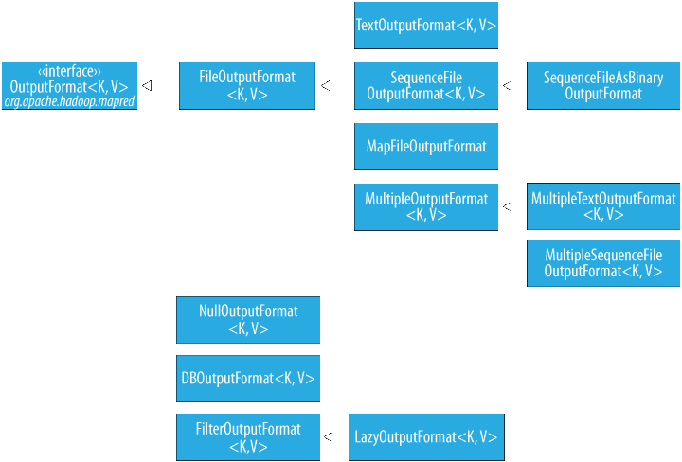
Output Formats

Slide 47
Sample Mapper
public class MaxTemperatureMapper extends MapReduceBase
implements Mapper<LongWritable, Text, Text, IntWritable> {
public void map(LongWritable key, Text value,
OutputCollector<Text, IntWritable> output, Reporter reporter)
throws IOException {
String line = value.toString();
String year = line.substring(15, 19);
int airTemperature;
if (line.charAt(87) == '+') { // parseInt doesn't like leading plus signs
airTemperature = Integer.parseInt(line.substring(88, 92));
} else {
airTemperature = Integer.parseInt(line.substring(87, 92));
}
String quality = line.substring(92, 93);
if (airTemperature != MISSING && quality.matches("[01459]")) {
output.collect(new Text(year), new IntWritable(airTemperature));
}
}

Slide 48
Sample Reducer
public class MaxTemperatureReducer extends MapReduceBase
implements Reducer<Text, IntWritable, Text, IntWritable> {
public void reduce(Text key, Iterator<IntWritable> values,
OutputCollector<Text, IntWritable> output,
Reporter reporter) throws IOException {
int maxValue = Integer.MIN_VALUE;
while (values.hasNext()) {
maxValue = Math.max(maxValue, values.next().get());
}
output.collect(key, new IntWritable(maxValue))
}
}

Slide 49
Sample Driver
public static void main(String[] args) throws IOException {
JobConf conf = new JobConf(MaxTemperature.class);
conf.setJobName("Max temperature");
FileInputFormat.addInputPath(conf, new Path(args[0]));
FileOutputFormat.setOutputPath(conf, new Path(args[1]));
conf.setMapperClass(MaxTemperatureMapper.class);
conf.setReducerClass(MaxTemperatureReducer.class);
conf.setOutputKeyClass(Text.class);
conf.setOutputValueClass(IntWritable.class);
JobClient.runJob(conf);
}

Slide 50

Source
Hadoop – The definitive Guide
http://hadoop.apache.org/
http://hadoop.apache.org/common/docs/r0.20.2/mapred_tutorial.html
http://hadoop.apache.org/hdfs/
Disclaimer: Parts of the content of this course is based on the materials available from the Web sites and books listed above. The materials that can be accessed from linked sites are not maintained by Cognizant Academy and we are not responsible for the contents thereof. All trademarks, service marks, and trade names in this course are the marks of the respective owner(s).

Slide 51
Test Your Understanding
What are the types of Input formats ?
What are the types of output formats ?
Where is combine Input format used and why?

Slide 52
Summary
Hadoop supports a number of input and output formats based on the file formats to be read/written.
CombineLineInput format is used to alleviate the problem of small files in hadoop.
TextInput format is the default format.
NlineInputFormat takes number of lines a s a logical record.
Sequence file format stores sequences of binary key-value pairs.

Slide 53
Questions

Slide 54
Big Data
You have successfully completed –
MapReduce Basics Course

